Slide 1
In House Use and Alma Analytic reports for In House use
Yoel Kortick
Senior Librarian

Slide 2
Copyright Statement
All of the information and material inclusive of text, images, logos, product names is either the property of, or used with permission by Ex Libris Ltd. The information may not be distributed, modified, displayed, reproduced – in whole or in part – without the prior written permission of Ex Libris Ltd.
TRADEMARKS
Ex Libris, the Ex Libris logo, Aleph, Alma, SFX, SFXIT, MetaLib, DigiTool, Verde, Primo, Voyager, MetaSearch, MetaIndex and other Ex Libris products and services referenced herein are trademarks of Ex Libris, and may be registered in certain jurisdictions. All other product names, company names, marks and logos referenced may be trademarks of their respective owners.
DISCLAIMER
The information contained in this document is compiled from various sources and provided on an "AS IS" basis for general information purposes only without any representations, conditions or warranties whether express or implied, including any implied warranties of satisfactory quality, completeness, accuracy or fitness for a particular purpose.
Ex Libris, its subsidiaries and related corporations ("Ex Libris Group") disclaim any and all liability for all use of this information, including losses, damages, claims or expenses any person may incur as a result of the use of this information, even if advised of the possibility of such loss or damage.
© Ex Libris Ltd., 2011

Slide 3
Agenda
Introduction and overview
Workflow
The return and in house use
Retrieving and Viewing in Analytics

Slide 4
Introduction and overview
In house use is a method to know which items are in use even if they were not actually loaned.
This may include items which are loanable as well as those which are not loanable.
Items may have been used in the library and not registered to a specific patron as a loan.
Thus checking only “regular” loans is not enough to know which items in inventory were actually used

Slide 5

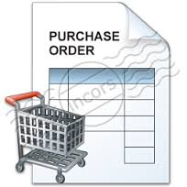
Introduction and overview
It is important for libraries to know which items are and are not being used
To implement a weeding process.
To purchase additional copies of high demand items
http://livingcolorgardencenter.net/wordPress/
http://iconfu.com/v_collection/icons/?icon=purchase_order_cart

Slide 6

Introduction and overview
These items were (probably) used in house today.
Patrons used them and left them on the table
http://www.flickr.com/photos/ericejohnson/4117596207/

Slide 7

Introduction and overview
These items were (probably) not used in house today.
They are still neatly on the shelf
http://camelshump.files.wordpress.com/2012/02/library.jpg

Slide 8
Agenda
Introduction and overview
Workflow
The return and in house use
Retrieving and Viewing in Analytics

Slide 9
Workflow
In many libraries the flow includes the following:
At the end of the day (or periodically throughout the day) items are removed from the tables and study carols of the library
Before the items are physically returned to their location they are “returned” (scanned in) in Alma
The items are “returned” even though they are not actually on loan in order to trigger an associated “in house use”

Slide 10
Workflow
Take off tables and study carrels
Bring to circulation desk
Scan in as return
Place in permanent location

Slide 11
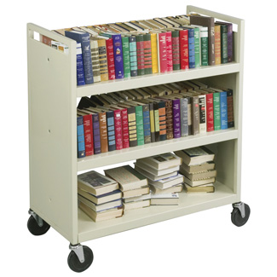

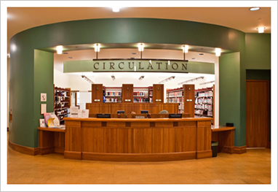
Workflow
2.
1.
http://www.flickr.com/photos/ericejohnson/4117596207/
http://crplteen.files.wordpress.com/2011/06/new-image.jpg
4.
3.
http://crplteen.files.wordpress.com/2011/06/new-image.jpg
http://camelshump.files.wordpress.com/2012/02/library.jpg
http://www.law.ucla.edu/library/tour/first/Pages/circulation.aspx

Slide 12
Agenda
Introduction and overview
Workflow
The return and in house use
Retrieving and Viewing in Analytics

Slide 13
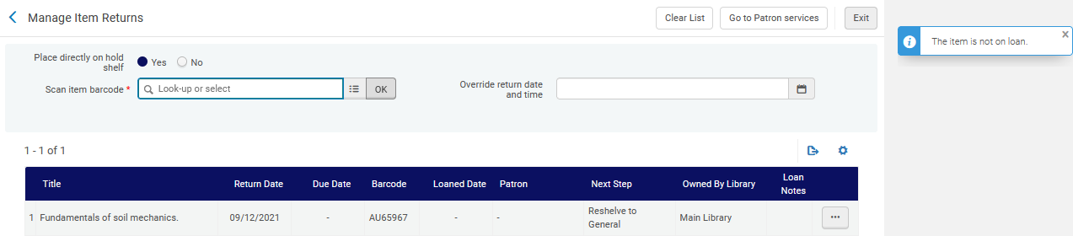
The Return and in house use
The return is made on the item which does not have a loan:
Alma indicates that the item is not on loan
This item was likely taken off a table or misplaced with other items which were returned with a loan.

Slide 14
The Return and in house use
We will now be able to see that this item has an “in house use” in three ways:
“Other Details” link from physical item repository search
“History” tab and fulfillment activities radio button in Physical item editor
Alma Analytics using the “In House Loan Indicator”

Slide 15
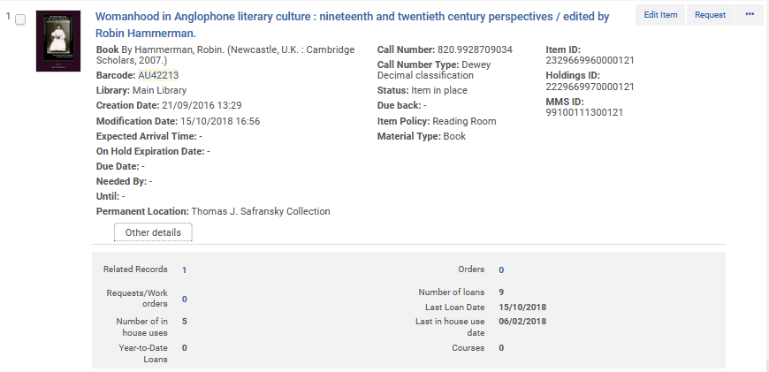
The Return and in house use
Each time the return is made for the item which does not have a loan an “in house use” is registered:
Viewable via “Other Details”

Slide 16
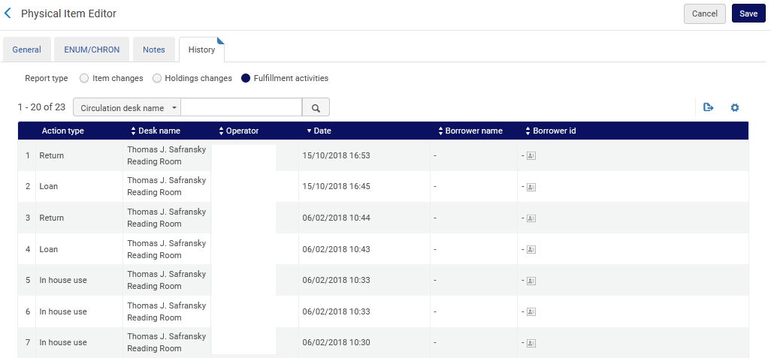
The Return and in house use
The in house use is also visible via physical item editor history tab fulfillment activities.
Operator details erased from screenshot for privacy reasons.

Slide 17
Agenda
Introduction and overview
Workflow
The return and in house use
Retrieving and Viewing in Analytics

Slide 18
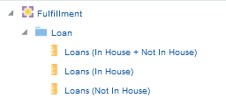
Retrieving and Viewing in Analytics
It is possible to retrieve the information pertaining to the in-house use via Alma Analytics “Fulfillment” subject area.
There are measures for this:
Loans (In House + Not In House)
Loans (In House)
Loans (Not in House)

Slide 19
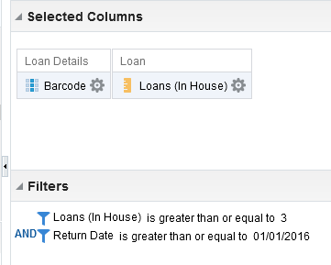
Retrieving and Viewing in Analytics
Here is a report “criteria” which retrieves all items (barcodes) and number of in house use transactions for items with three or more “in house use” transactions since Jan. 01, 2016
Will display barcode and number of in house loans
Filters only for
items with 3 or more in house loans
retuned after or on Jan. 01 2016

Slide 20
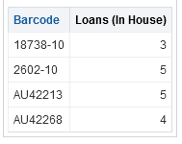
Retrieving and Viewing in Analytics
Here are the results of the Analytics report.
All of these items were used in house three or more times since Jan. 01, 2016.
We will now go look at the first example here where it states there were three in house loans on or after Jan. 2016.
It is barcode 18738-10.

Slide 21
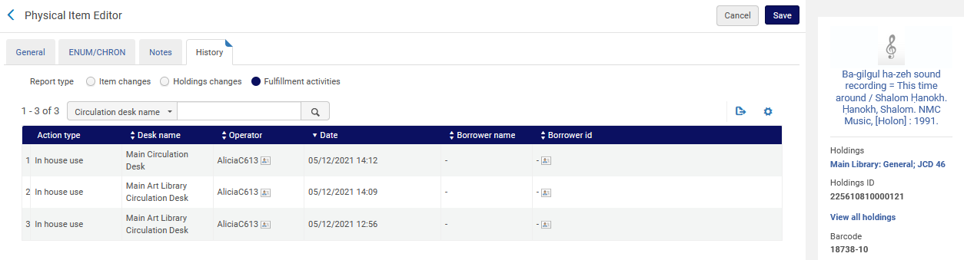
Retrieving and Viewing in Analytics
Here is first item from the list: barcode 18738-10
Physical item editor history tab for fulfillment activities
Three in house loans from after Jan. 1, 2016

Slide 22
Retrieving and Viewing in Analytics
We will now go look at the second example here where it states there were five in house loans on or after Jan. 2016.
It is barcode 2602-10.

Slide 23
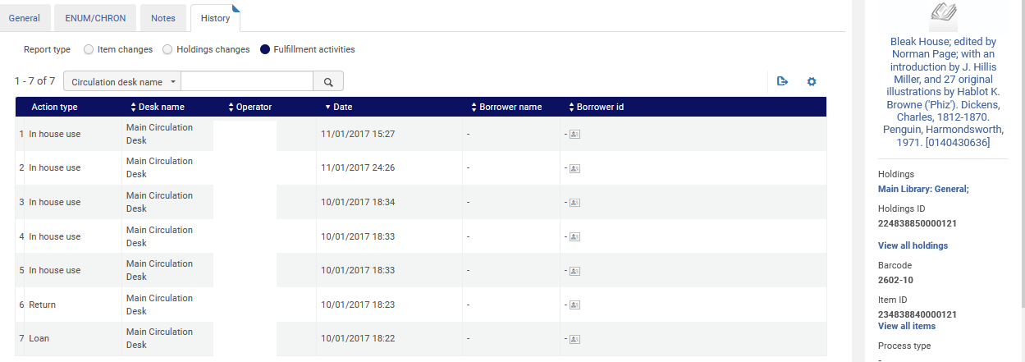
Retrieving and Viewing in Analytics
Here is second item from the list: barcode 2602-10
Physical item editor history tab for fulfillment activities
Five in house loans from after Jan. 1, 2016

